Slide 1
Introduction to HTML5 and CSS3: Day 2 Dr. Naveen Kumar, BES-1

Slide 2
Agenda
HTML Document
Basic Structure of HTML Document
Creating HTML Document
Basic HTML elements
HTML element with Attributes
Line break (vertical and horizontal) and HTML tags
Style Attribute

Slide 3
HTML Document
Nested HTML Elements
The <html> element is the root element and it defines the whole HTML document.
The <head> element is where we given meta data about the webpage. <title> and others
The <body> element defines the document's body.
The elements with no content are called empty elements.

Slide 4
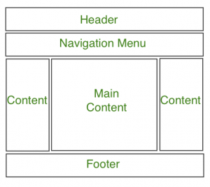
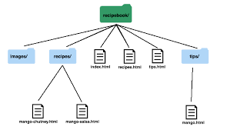
HTML Document Structure

Slide 5
Basic Basic HTML Elements
the heading <h1>-<h6> tags,
the <p> tag,
the <img /> tag,
the <a> tag

Slide 6
HTML Attributes
All HTML elements can have attributes
Attributes provide additional information about elements
Attributes are always specified in the start tag
Attributes usually come in name/value pairs like: name="value"

Slide 7
HTML Formatting
<b> - Bold text
<strong> - Important text
<i> - Italic text
<em> - Emphasized text
<mark> - Marked text
<small> - Smaller text
<del> - Deleted text
<ins> - Inserted text
<sub> - Subscript text
<sup> - Superscript text
<pre> preformatted Tag

Slide 8
HTML Formatting (cont.)
The HTML <b> element defines bold text, without any extra importance.
The HTML <strong> element defines text with strong importance. The content inside is typically displayed in bold.
<address> for address text format
Text Abbreviation <abbr>
Acronym Element <acronym>
Special Terms <dfn>
Text Direction <bdo>
Quoting Text <blockquote>
Short Quotations <q>

Slide 9
Computer Code <code>
Keyboard Text <kbd>
Programming Variables <var> together with <code> or <pre>
Program Output <samp>

Slide 10
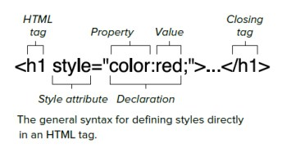
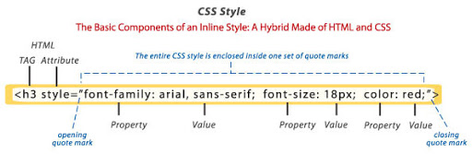
The Style Attribute

Slide 11
The Style Attribute (cont.)
<tagname style="property:value;">
Background Color
<p style="background-color:powderblue;">…</p>
Set background color for two different elements:
Text Color
<h1 style="color:blue;">This is a heading</h1> <p style="color:red;">This is a paragraph.</p>
Fonts
<h1 style="font-family:verdana;">This is a heading</h1> <p style="font-family:courier;">This is a paragraph.</p>

Slide 12
The Style Attribute (cont.)
Text Size
<h1 style="font-size:300%;">This is a heading</h1> <p style="font-size:160%;">This is a paragraph.</p>
Text Alignment
<h1 style="text-align:center;">Centered Heading</h1> <p style="text-align:center;">Centered paragraph.</p>

Slide 13
Style Summary
Use the style attribute for styling HTML elements
Use background-color for background color
Use color for text colors
Use font-family for text fonts
Use font-size for text sizes
Use text-align for text alignment

Slide 14
Image in HTML

Slide 15
List and Table
Unordered List
Ordered List

Slide 16
Table in HTML

Slide 17
Thank you

